Slide 1
PrintNet T Triple Suite
Data Sorter

Slide 2
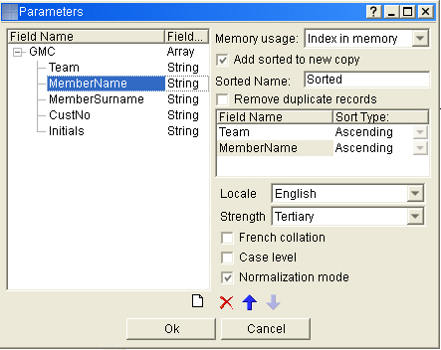
Basic concept
Used to sort data to entered criteria
Each Field Specification
New sorted array
Notes:
Used to sort data to entered criteria
Specifies each field and its order (Ascending or Descending), and its priority.
Can create new sorted array from an array on data input, so there will be two different arrays (the first will contain raw data and the second one will contain sorted data)

Slide 3
Set-up
Field to be sorted
Sorting rules
Notes:
Field to be sorted – which variable will be sorted
Sorting rules ascending, descending
Use the buttons at the bottom of the dialog to add or remove fields, or to change the order of the fields. (Blue Arrows)
Add sorted to new copy creates a new array for sorted data. If this option is not checked, and there are still some fields selected for sorting, these fields will be sorted within their current array (i.e., no new array is created).

Slide 4
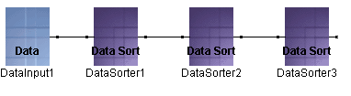
Add sorted to new copy option
Data processing in the order defined by the original sequence, while sorting the data for other purposes.
DataSorters modules (with Add sorted to new copy option checked) to obtain several sorted data arrays
Notes:
Useful to process data (print records) in the order defined by the original sequence in the datafile, while also sorting the data inside the layout for other purposes.
Concatenate several DataSorter modules (with Add sorted to new copy option checked) to obtain several data arrays sorted by other criteria and use them later in the layout.

Slide 5

Any Questions? Thank You.

